Slide 1
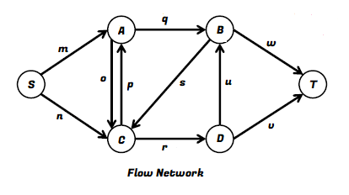
Max Flow Problem
Problem Statement
Maximum Flow (Max Flow) problems involve finding a feasible flow through a single-source, single-sink flow network that is maximum.
Input: A flow network along with a source and a sink, where each edge is labeled with a capacity, the maximum amount of stuff that it can carry.
Goal: To figure out the maximum amount of stuff in total that can be pushed from the vertex S (source) to the vertex T (sink).

Slide 2
Max Flow Problem
Flow Network
A Flow network is a directed graph involving a source (S) and a sink (T) and several other nodes connected with edges where each edge has a capacity and a flow.
Capacity
Let, Ei be an edge in a flow network between nodes u and v. Capacity of Ei is the maximum limit of flow/stuff that can be carried by Ei from u to v. It is represented by c(Ei).
Flow
Let, Ei be an edge in a flow network between nodes u and v. Flow along Ei is the exact amount of flow/stuff that is carried at any given time by Ei from u to v. It is represented by f(Ei).

Slide 3
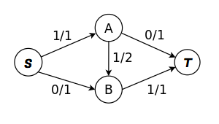
Max Flow Problem
Relation Between Flow and Capacity of an Edge in a Flow Network
0 <= f(Ei) <= c(Ei)
For example, Think of an Highway!
Suppose, It’s maximum capacity is 5 cars at a time, that is maximum 5 cars can cross/use that highway all together at any given time.
So, the flow along the highway at any given time can be ranged from 0 to 5, that is at any certain time, there can be no cars on that highway, there can be two cars crossing that road together, there can be four but at max it can be five! More than five cars is not allowed to cross the highway at any given time!
In a Flow network, when an edge is labeled as x/y, it means that the edge has flow x and capacity y.

Slide 4
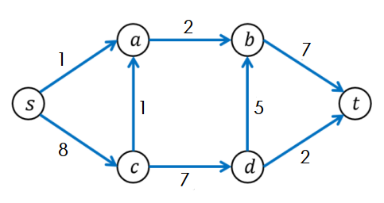
Max Flow Problem
Properties of a Flow Network
For any non-source and non-sink node, the input flow is equal to output flow.
In-degree of the source node is zero and out-degree of the sink node is zero.
For any edge Ei in the network, 0 <= f(Ei) <= c(Ei), that is edge's flow must be nonnegative and may not exceed its capacity. This constraint is known as feasibility condition.
Total flow out of the source node is equal total to flow in to the sink node. This constraint is known as flow conservation condition.
Maximum Flow
It is defined as the maximum amount of flow that the network would allow to flow from source to sink following all the properties of flow network.

Slide 5
Max Flow Problem using Naïve Greedy Approach
How Greedy Approach works to find the maximum flow of a Flow Network – Pseudocode:
Given, a flow network, a source, a sink and the capacity of each edge c(e)
Initialize max_flow and flow of each edge f(e) to 0 (zero)
// A path exists if f(e) < c(e) for every edge e on the path P
// A path is considered blocked/invalid if f(e) == c(e) for any edge e on the path P
Repeat searching for a valid s-t path P while it exists
Find if there is a path from s to t using BFS or DFS
If a path found,
//find minimum remaining edge capacity value for path P (as flow is limited by least remaining capacity edge on path P) and set it as flow value of P
path_flow = min (c(e) - f(e)) //for every edge e on the path P
max_flow += path_flow
for every edge e on the path
f(e) += path_flow
Return max_flow

Slide 6
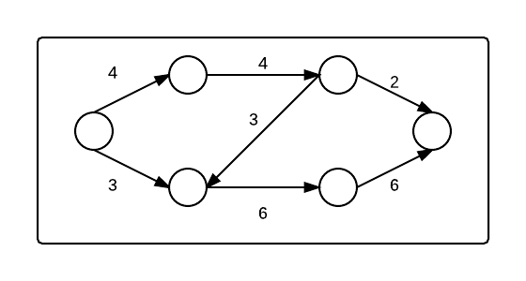
Max Flow Problem using Naïve Greedy Approach - Example
How Greedy Approach works to find the maximum flow of a Flow Network - Example:
0/
0/
A
C
0/
0/
S
T
0/
B
D
0/
0/
max_flow = 0
path | path_flow | max_flow
S→ A → C → T
2
2

Slide 7
Max Flow Problem using Naïve Greedy Approach - Example
How Greedy Approach works to find the maximum flow of a Flow Network - Example:
2/
2/
A
C
2/
0/
S
T
0/
B
D
0/
0/
path | path_flow | max_flow
S→ A → C → T
2
2
S→ B → D → T
3
5

Slide 8
Max Flow Problem using Naïve Greedy Approach - Example
How Greedy Approach works to find the maximum flow of a Flow Network - Example:
2/
2/
A
C
2/
0/
S
T
3/
B
D
3/
3/
path | path_flow | max_flow
S→ A → C → T
2
2
S→ B → D → T
3
5
S→ A → C → B → D → T
2
7

Slide 9
Max Flow Problem using Naïve Greedy Approach - Example
How Greedy Approach works to find the maximum flow of a Flow Network - Example:
4/
4/
A
C
2/
2/
Maximum flow of this flow network is 7 units!
S
T
3/
B
D
5/
5/
path | path_flow | max_flow
S→ A → C → T
2
2
S→ B → D → T
3
5
S→ A → C → B → D → T
2
7

Slide 10
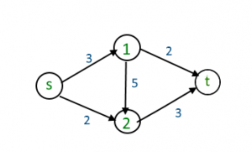
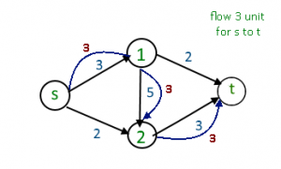
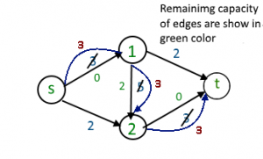
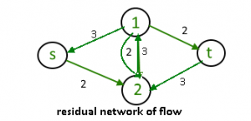
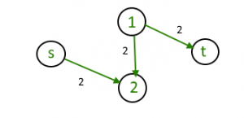
Ford-Fulkerson Algorithm
Invented by Ford and Fulkerson in 1956.
This algorithm is used to calculate the maximum flow of flow network.
This algorithm extends the idea of the naïve greedy algorithm of calculating the maximum flow of a flow network by allowing important “undo” operations. It does so by using concept of Residual Network.
For example:
Maximum flow is 3 unit!
Can 5 unit be achievable?

Slide 11
Ford-Fulkerson Algorithm
Residual Network:
The formal way of introducing the allowable “undo” operation is to utilize the concept of Residual Network
A residual network indicates how much more flow is allowed in each edge in the flow network.
Idea: Given a Flow Network G and a flow f in it along path P, a Residual Network G_{R} is formed that has
the same vertex set of G and
two edges for each edge of G corresponding to that particular flow along the path P-
forward edge with capacity c(Ei) – f(Ei) (the room remaining → residual capacity)
backward edge with capacity f(Ei) (the amount of previously routed flow that can be undone).

Slide 12
Ford-Fulkerson Algorithm
Residual Capacity:
Residual capacity is defined as the new capacity just after a given flow has been taken place.
For any edge Ei, it is difference between the capacity c(Ei) and flow f(Ei)
r(Ei) = c(Ei) – f(Ei)
Augmenting Path:
An augmenting path is a simple path from source to sink which do not include any cycles and that pass only through positive weighted edges.
It is a directed path p starting at the source (S) and ending at the sink (T) such that the residual capacity r(Ei) for all edges on that path is nonzero.
p=(u1​,u2​,…,uk−1​,uk​) is a directed path with u1 = S and uk = T such that,
r(Ei) = c(Ei) – f(Ei) > 0
for all edges Ei = (ui, ui+1) for i = 1, …, k−1 in the path p.

Slide 13
Implementation of Ford-Fulkerson Algorithm – Worked Out Example
Calculate Maximum Flow (Max Flow) for the following Flow Network using Ford-Fulkerson Algorithm:
0/
V1
12
V3
Forward Edge’s Capacity will be r(e)
r(e) = c(e) – f(e)
0/
0/
20
16
4
Backward Edge’s Capacity will be f(e)
0/
S
0/
10
7
T
0/
0/
Total_Flow = 0
9
For AP the Last updated flow along e in FN
f(e) += Path_Flow, if forward edge in RN
f(e) -= Path_Flow, if backward edge in RN
13
4
0/
V2
V4
0/
0/
14
Flow Network (FN)
Residual Network (RN)
V1
12
V3
16
20
Path_Flow = 4
4
9
Augmenting Path (AP)
S → V1 → V3 → V2 → V4 → T
S
10
7
T
13
4
16
12
9
14
4
14
r(e) = Residual Capacity of e in RN
c(e) = Actual Capacity of e in FN
f(e) = Last Updated Flow along e in FN
V2
V4

Slide 14
Implementation of Ford-Fulkerson Algorithm – Worked Out Example
Calculate Maximum Flow (Max Flow) for the following Flow Network using Ford-Fulkerson Algorithm:
4/
V1
12
V3
4/
16
0/
20
Total_Flow += Path_Flow
4
0/
Total_Flow = 0 + 4 = 4
S
0/
10
7
T
4/
0/
9
13
4
0/
V2
V4
4/
Residual Network (RN)
4/
14
8
Flow Network (FN)
V1
V3
4
20
12
Path_Flow = 7
4
5
Augmenting Path (AP)
S → V1 → V2 → V4 → V3 → T
S
4
7
T
10
4
0
12
10
10
7
20
13
V2
10
V4
4
4

Slide 15
Implementation of Ford-Fulkerson Algorithm – Worked Out Example
Calculate Maximum Flow (Max Flow) for the following Flow Network using Ford-Fulkerson Algorithm:
4/
V1
12
V3
11/
7/
20
16
4
0/
Total Flow = 4 + 7 = 11
S
7/
10
7
T
4/
7/
9
13
4
0/
V2
V4
4/
Residual Network (RN)
11/
14
8
Flow Network (FN)
V1
V3
4
13
5
Path_Flow = 8
11
7
5
Augmenting Path (AP)
S → V2 → V1 → V3 → T
11
7
S
4
0
7
T
3
4
13
11
8
13
13
V2
3
V4
4
11

Slide 16
Implementation of Ford-Fulkerson Algorithm – Worked Out Example
Calculate Maximum Flow (Max Flow) for the following Flow Network using Ford-Fulkerson Algorithm:
V1
12/
12
V3
11/
15/
20
16
/4
1
8
Total Flow =11 + 8 = 19
S
0
7
T
7
/10
4/
7/
9
8/
13
4
V2
V4
4/
Residual Network (RN)
11/
14
0
Flow Network (FN)
V1
V3
12
5
5
Path_Flow = 4
11
3
5
Augmenting Path (AP)
S → V2 → V3 → T
S
11
15
4
7
T
5
0
1
5
4
5
10
8
V2
3
V4
4
11

Slide 17
Implementation of Ford-Fulkerson Algorithm – Worked Out Example
Calculate Maximum Flow (Max Flow) for the following Flow Network using Ford-Fulkerson Algorithm:
V1
12/
12
V3
19/
11/
20
16
/4
1
Total Flow =19 + 4 = 23
S
0
/10
7
T
0/
7/
9
12/
13
4
V2
V4
4/
Residual Network (RN)
11/
14
V1
V3
Flow Network (FN)
12
1
5
3
Augmenting Path (AP)
No more s-t
augmenting path exist
11
9
S
11
19
0
7
T
1
12
V2
3
V4
4
11
So, the Maximum Flow in the given FN is 23

